Slide 1
AME20216 - Lab I L7 – Electric Power

Slide 2
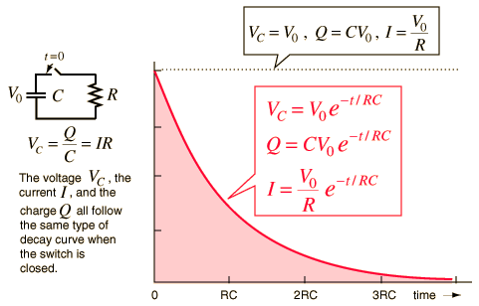
Charging of a Capacitor
RC time constant – time it takes capacitor to charge or discharge by 63% - “electrical response time”
http://hyperphysics.phy-astr.gsu.edu

Slide 3
Memorize it:
At t = τ…

Slide 4
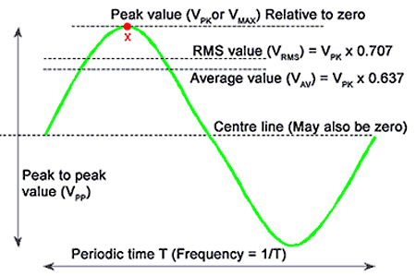
Alternating Current (AC)
www.learnabout-electronics.org
|V| “peak amplitude”
V_{pp} = 2|V| “peak-to-peak”
“root-mean-square”

Slide 5
Memorize it:

Slide 6
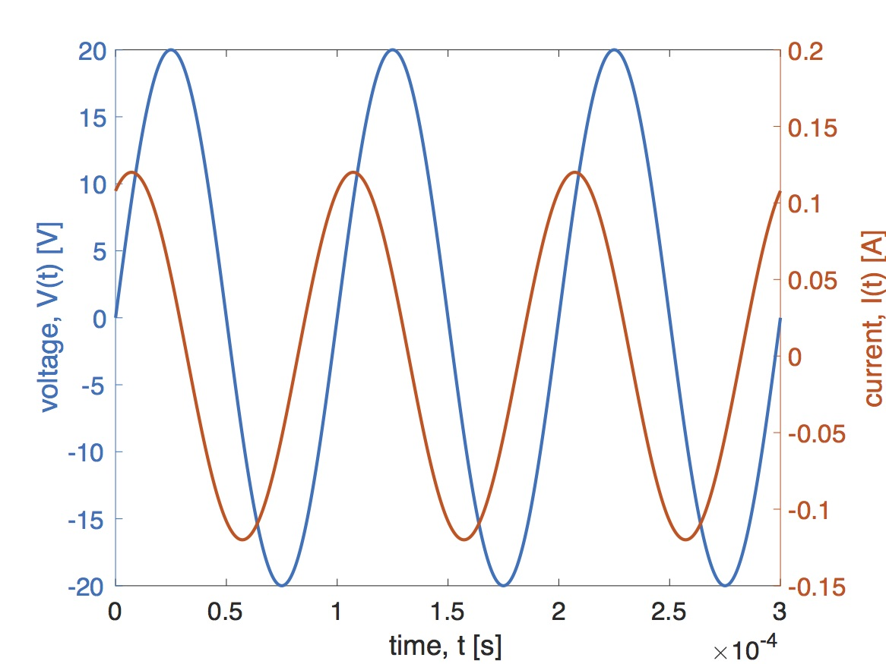
Alternating Current

Slide 7
High-pass Filter
Low-pass Filter
Band-pass filter
Notch filter

Slide 8
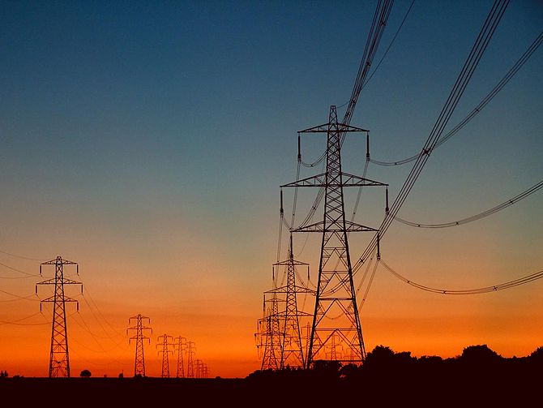
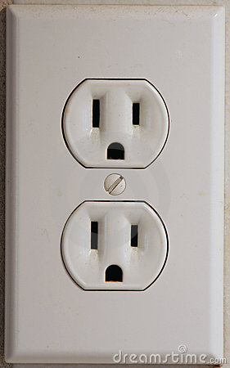
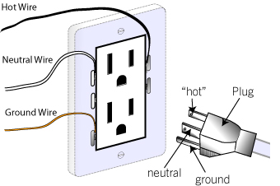
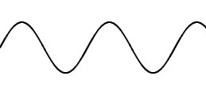
The AC Power Grid
60 Hz, 120 V_{RMS}

Slide 9
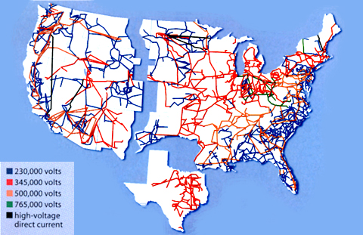
The AC Power Grid
Electrical energy distributed across nation via AC transmission lines.
https://www.technologyreview.com/s/401083/a-smarter-power-grid/

Slide 10
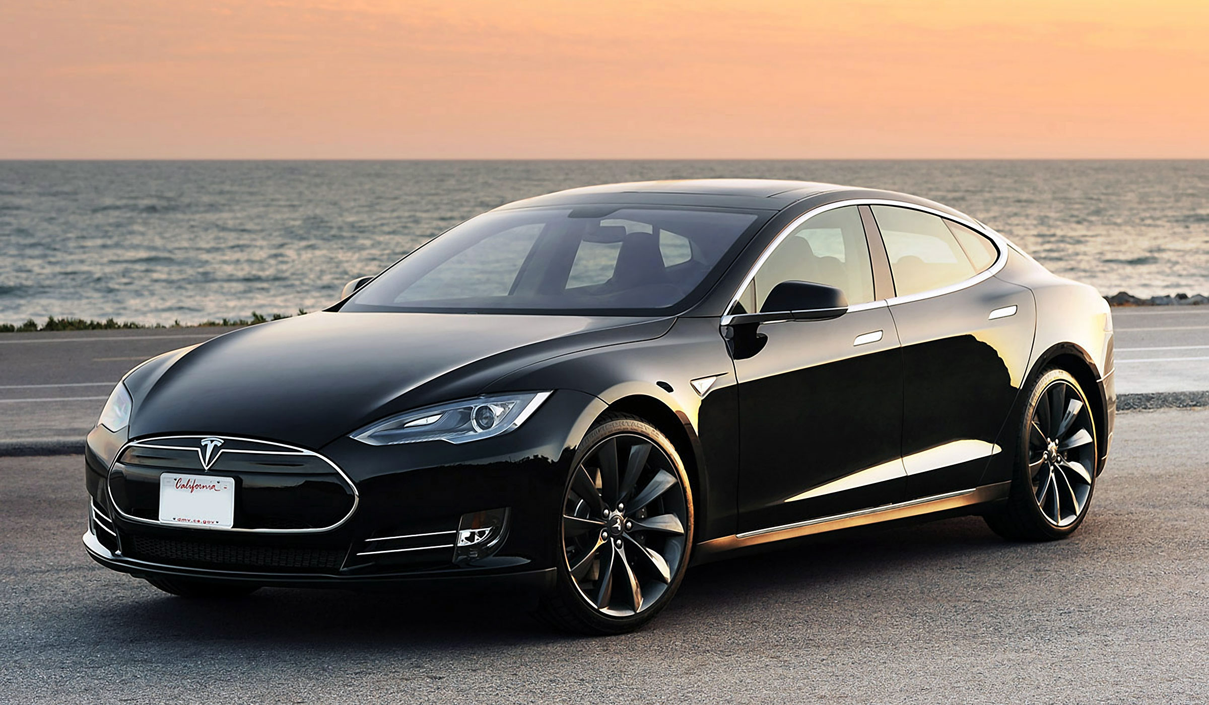
Tesla Models S – 400 HP AC Induction Motor

Slide 11
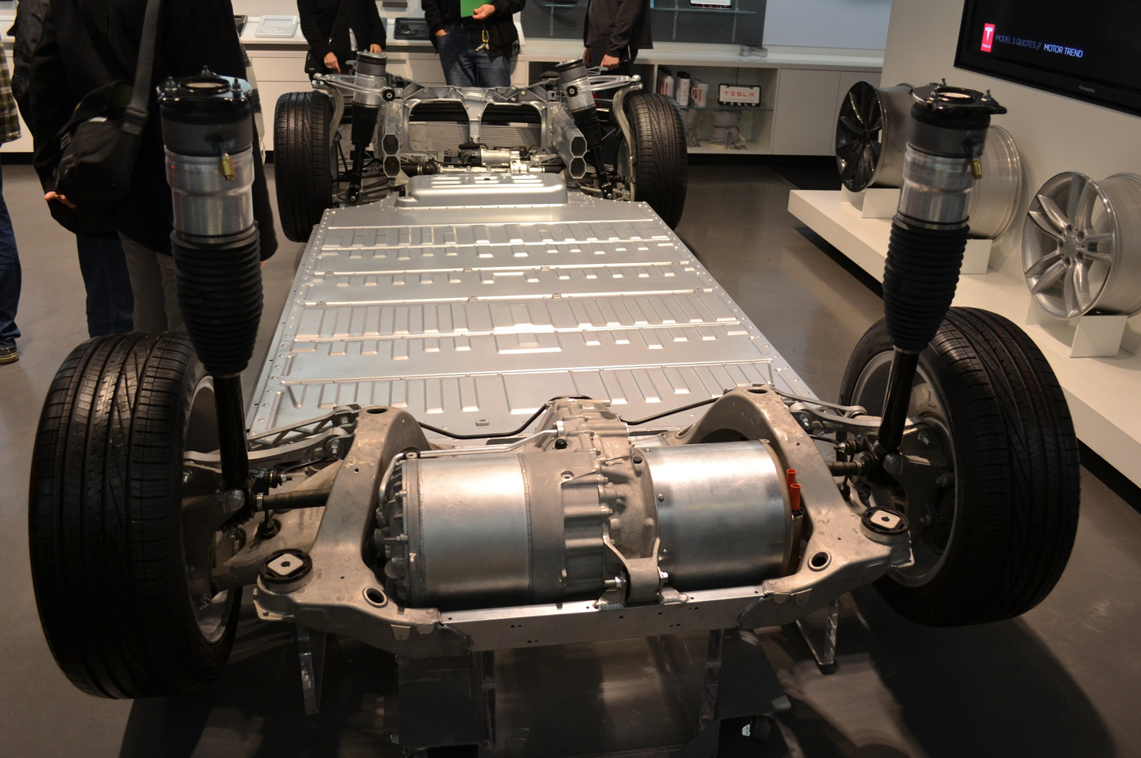
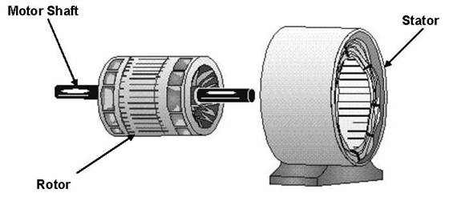
55 Hz AC Induction Motor – 10³ Amps at 300 V
300,000 W = 400 HP
Instantaneous torque!
No transmission, no fuel pump, no water pump, no valves… Very few moving parts!

Slide 12
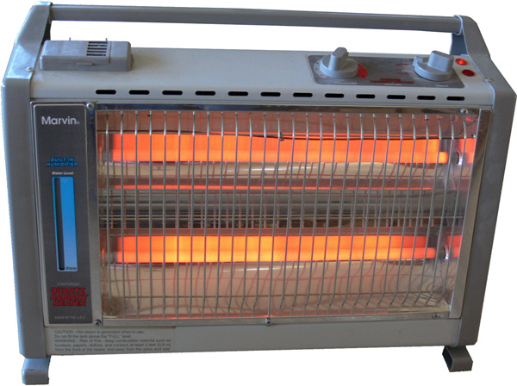
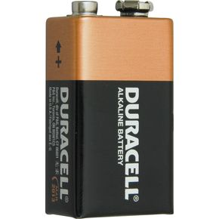
Non-ideal Power Supply
Power supplies and batteries have an “internal resistance” or “output impedance” that limits the amount of current it can output.

Slide 13
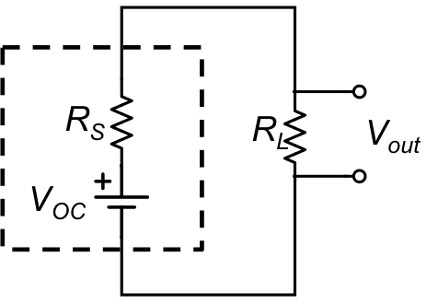
Non-ideal Power Supply
Power supplies and batteries have an “internal resistance” or “output impedance” that limits the amount of current it can output.
Voltage “Droop”

Slide 14
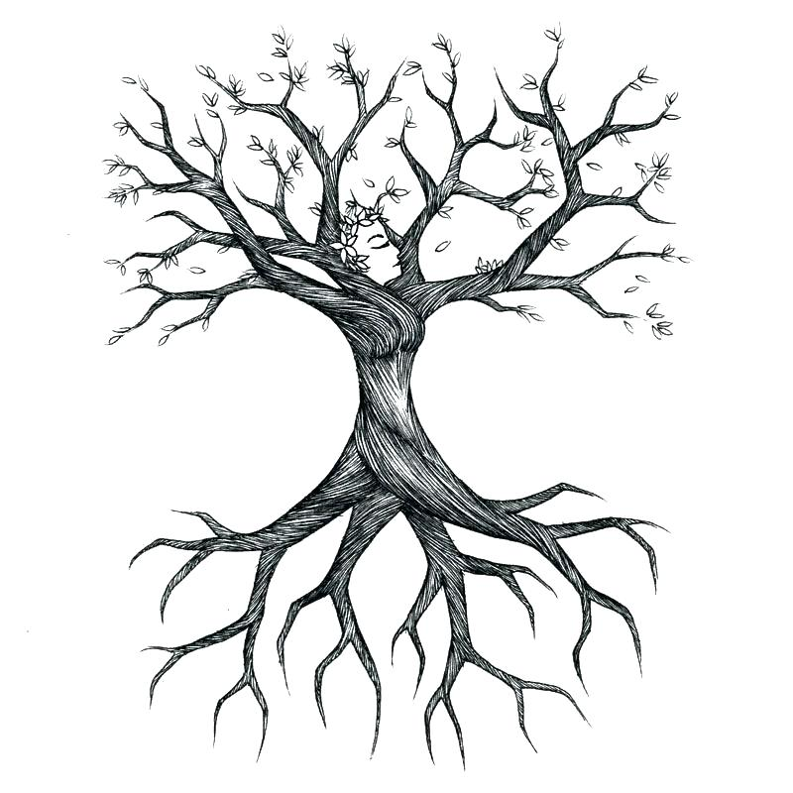
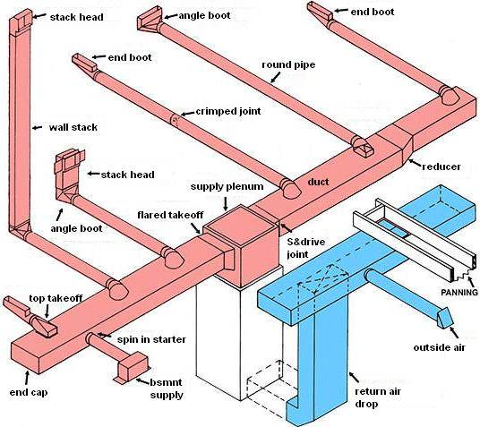
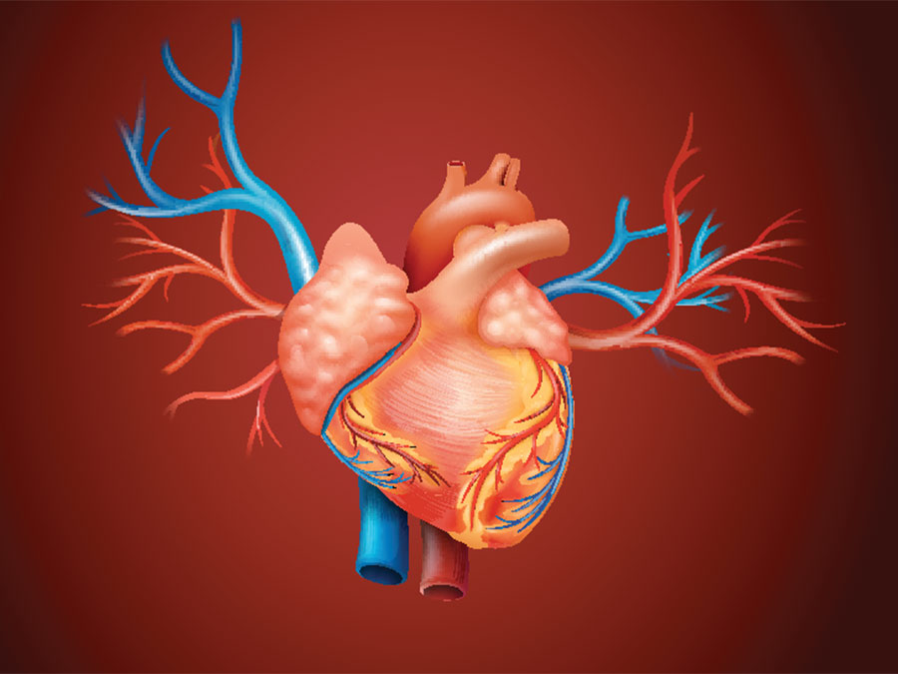
Impedance Matching
Subsequent branches are “impedance matched”

